Slide 1

Celtra Challenge
Jackpot
Andraž Hribernik
December 10, 2014

Slide 2
Content
Problem description
Multi Armed Bandit
Results
Conclusion

Slide 3
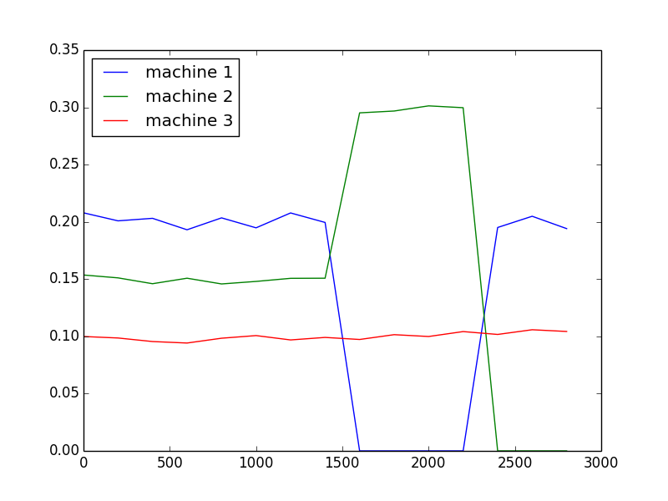
Problem description
Jackpot
• GOAL → earn as much as possible
• Sampling training examples → got machines’ CTR through time
• Implement own service with the same API
known machines’ CTR
lower network latency → faster evaluation process

Slide 4
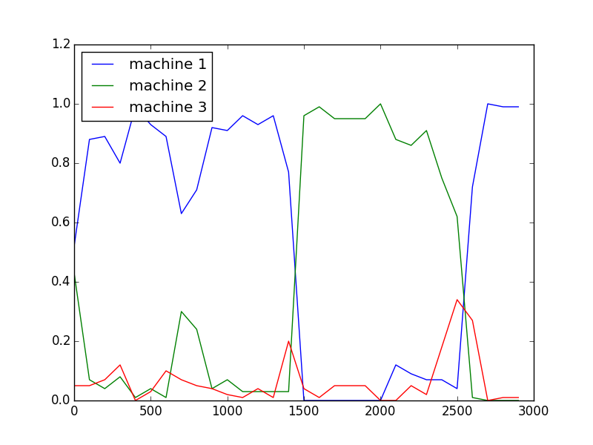
Multi Armed Bandit
MAB
• Trade-off between exploring vs. exploiting
• Many different techniques (ε-greedy, exp3, ucb1, ucb2, rpm)
• best performances → rpm using time interval

Slide 5
Results
• 1-5 training examples → 90% of perfect score
• 6-10 training examples → 84%
• All training examples → 86%
Total reward on training examples (Celtra) → 3475

Slide 6
Conclusion
• 5 dfferent MAB aproaches were tested
• we would earn approx. 85% of maximum possible reward
• very simple method to implement

Slide 7

Thank you
Source code: https://github.com/andrazhribernik/jackpot
Presentation: http://bit.ly/1G7tO1G

Slide 8
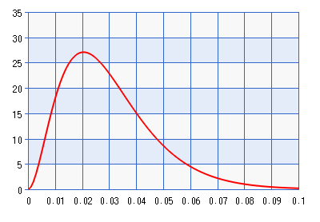
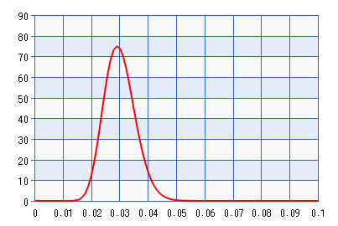
Randomised Probability Matching
• both machines have CTR 3%
• Left was shown 100 times
• Right was shown 1000 times

